Slide 1
Verification of Maestro 2 and co-simulation Algorithms
Simon Thrane Hansen

Slide 2
Who am i?
Simon Thrane Hansen
PhD student at AU
Supervised by Stefan Hallerstede, Jaco van de Pol and John Hatcliff (Kansas State)
Research Interest:
Theorem Proving
Problem solving
Logic

Slide 3
Agenda
Verification of Co-Simulation Algorithms
Future Perspective on Verification of Maestro 2
Questions

Slide 4
Current work
Co-simulation Algortihm Verifier
Model-checking: Uppaal
Program Transformations
Theorem Proving: Isabelle
Synthezesing Co-simulation Algortihms
Constraints solving: Z3

Slide 5
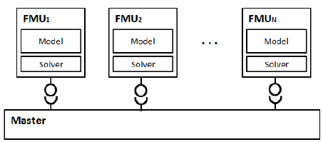
Co-simulation Algorithms
Obtaining a trustworthy co-simulation result is dependent on a correct Master Algorithm.
Composing simulation units to simulate their combined behaviour
The couplings between the simulation units denote a dependency
Co-simulation runs for days - an incorrect algrotihm can be costly!
The Master Algorithm dictates how the different simulation units interact.

Slide 6
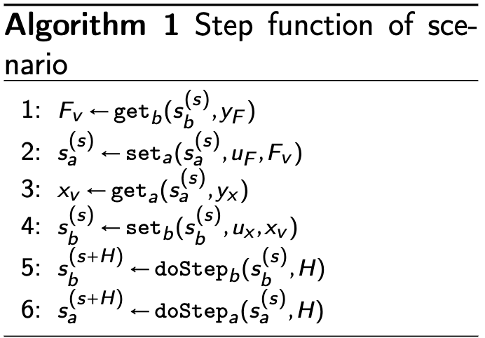
How to Construct such an Algorithm
A Master Algorithm (MA) is an ordered sequence of function calls (Get, Set, DoStep, Restore, Save) to be performed on the simulation units.
It contains both the Initialization procedure and Co-Simulation Step procedure.

Slide 7
Generation of algoritms
Generation of Co-Simulation Algorithms is difficult because:
Each Co-Simulation Scenario is different
Trivial scenarios
Non-trivial scenarios
Handling of Algebraic Loops
Finding a common step size
The Implementation of an FMU affects the MA
Interpolation
Extrapolation
The order of the function calls
How do we ensure the correctness of such an Algorithm?

Slide 8
Verification of an Algorithm
We build a tool that given a master algorithm and a co-simulation scenario can formally verify the correctness of the Master Algorithm.

Slide 9
Co-Simulation scenarios
Different scenarios ➔ Different Configurations of Master Algorithms
Trivial scenarios:
No Algebraic Loops
Fixed-Step Co-Simulation Algorithm
Rollback not needed
Non-trivial scenarios
Algebraic Loops - a port depends on itself
Not capable of running a Fixed-Step Algorithm
Rollback needed

Slide 10
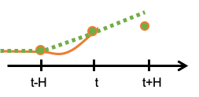
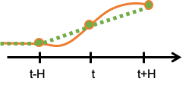
Extrapolation vs. Interpolation
Extrapolation (Reactive inputs):
An FMU calculates its future state based on values from the current time.
Interpolation (Delayed inputs):
An FMU calculates its future state based on future input values.

Slide 11
Criteria of a sound Master algorithm
The order of the function calls
A value should be retrived before it can be set
Delayed inputs at time t – values set should be a time t (Extrapolation)
Reactive inputs at time t – values set should be a time t+H (Interpolation)
Feedthrough – Input should be set before output can be retrieved
Time-progression
Algebraic Loop – a fixed-point should be obtained
After a co-simulation step all FMUs should be a the same time.
A sound Master Algorithm satisfies these Criteria (contracts) - Unfortunately it is too naive to handle non-trivial scenarios!

Slide 12
Why is it too naive?
Non-trivial co-simulation scenarios require a search for the correct configurations of the master algorithm.
An algebraic loop requires a fixed-point to be obtained on the output ports!
Until a fixed-point has not been obtained the contracts is violated!
This violation is unavoidable!

Slide 13
How to solve this?
Tolerate the violation while we iteratively search for a fixed-point.
Restoration of state is required after each iteration.
Insight: Once a fixed-point is obtained all FMU-contracts is satisfied!
NB. A fixed-point is not guaranteed to exists.

Slide 14
Reformulating the Soundness Criteria
Our original formulation of soundness for MA needs to be reformulated!
Trivial Scenarios
A sound Master Algorithm will for trivial scenarios never break an FMU-contract and will eventually terminate.
Non-Trivial Scenarios
A sound Master Algorithm will for non-trivial scenarios eventually find a configuration that does not break the FMU-contracts (if one exist) and will eventually terminate.

Slide 15
Uppaal Encoding
An Automata encapsulating the rules of a valid co-simulation algortihm.
Interpreter:
Simulates the MA
StepFinder:
Validates the procedure for finding a common step
LoopSolver:
Solving Algebraic Loops
FMU:
Interface of a FMU
The constraints are encoded as preconditions
This work is targeting FormaliSE 2021

Slide 16
Generation of Co-Simulation algorithms

Slide 17
Synthezesing Algorithms - Status
Constraints solving using Z3 using the constraints outlined in this presentation.
Trivial scenarios:
Fast and straightforward to compute
Still working on some optimizations
The actions can easily be calulated
Non-trivial scenarios:
Algebraic loops – unsatisfiable problem
Constraints need to be relaxed – But which?
Perhaps the unsatisfiable constraints could provide some kind of guidance

Slide 18
Possible Output From Synthesizer
cosim-step = [
{save-state: msd1}
{save-state: msd2}
{
loop: {
until-converged: [msd1.x1, msd1.v1, msd2.fk]
iterate: [
{set: msd2.x1}
{set: msd2.v1}
{step: msd2}
{get-tentative: msd2.fk}
{set-tentative: msd1.fk}
{step: msd1}
{get-tentative: msd1.x1}
{get-tentative: msd1.v1}
]
if-retry-needed: [
{restore-state: msd1}
{restore-state: msd2}
]
}
}
{get: msd1.z}
{set: msd2.z}
]

Slide 19
Looking into the future
Generation of Co-simulation Algortihm using SAT/SMT-solver
Program transformations and their useability
MaBL-expansion plugin for Synthesezier
MaBL – what can we show about a MaBL specification?
How can Slang be used to verify composition MaBL

